Slide 1
Planning and Navigation
Spring 2021

Slide 2
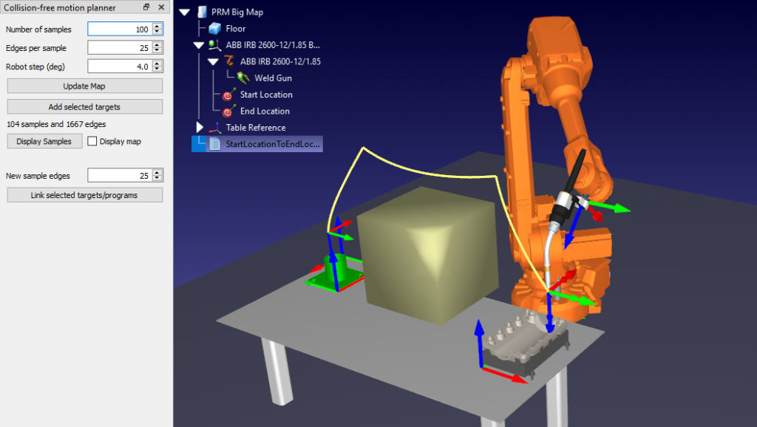
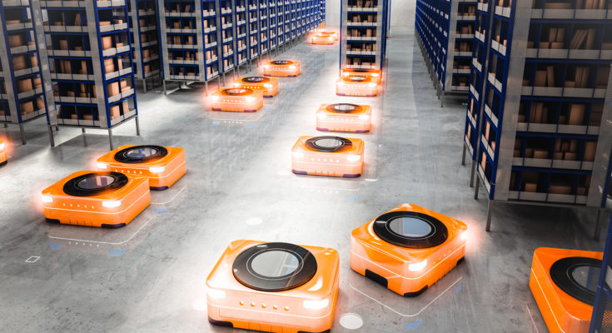
The Idea is Very Commonplace
https://robodk.com/blog/motion-planning-trend/
Why is it such a big trend??

Slide 3
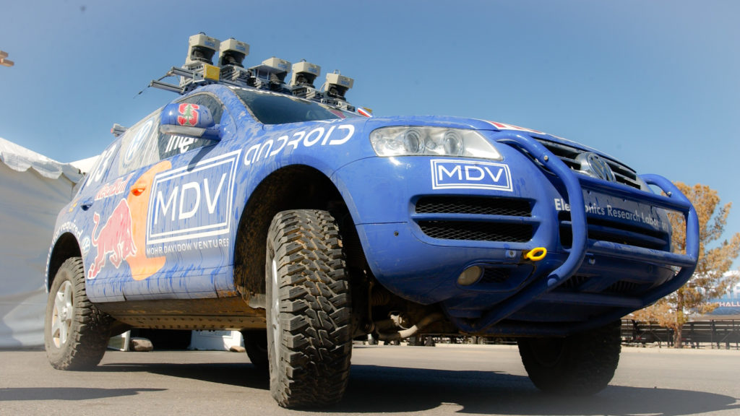
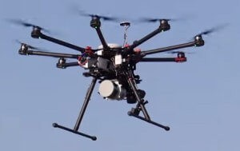
Why is It a Big Trend

Slide 4
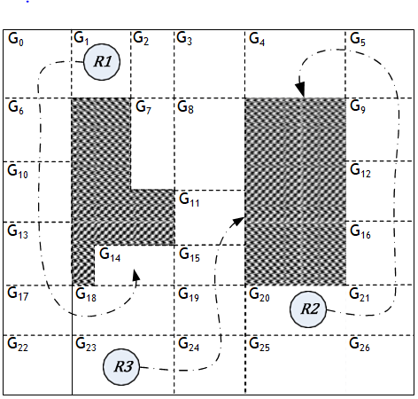
Classical AI Methods: Grid Based Planning

Slide 5
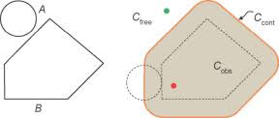
Classical AI Methods:Configuration Space Planning

Slide 6
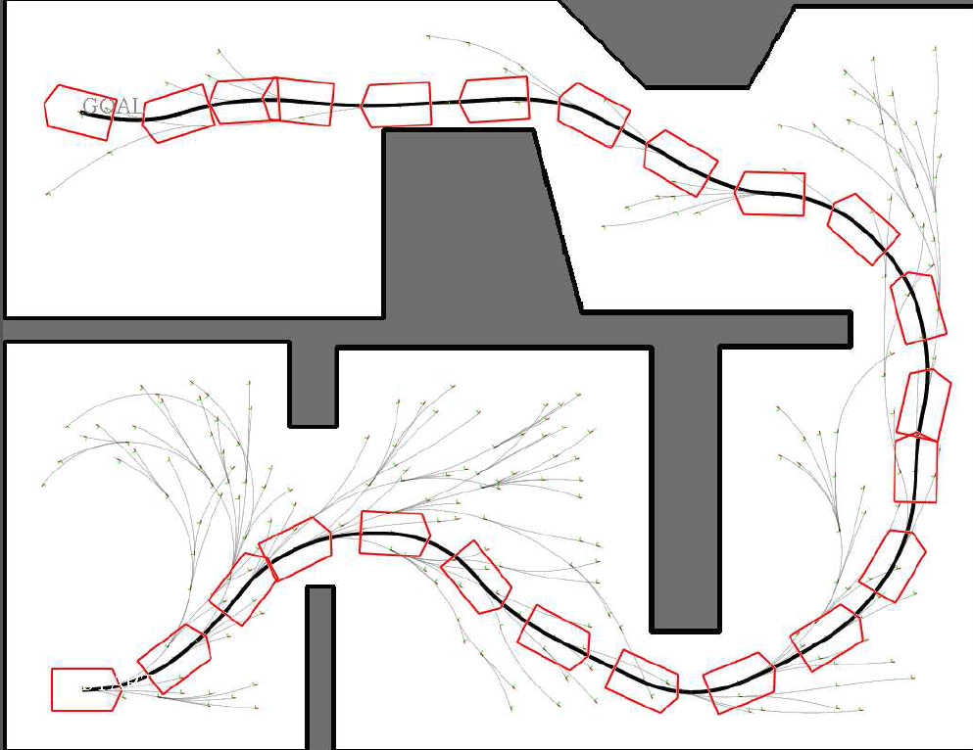
Kinematic Planning

Slide 7
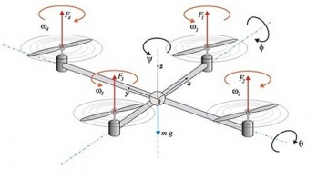
Dynamics Planning: Incorporating Force and Torques

Slide 8
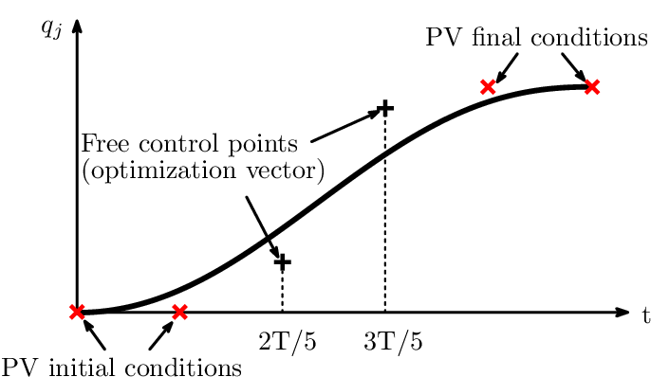
Optimization Methods: Trajectory Parametrization

Slide 9
Optimization Methods: Model Predictive Control
Play video

Slide 10
Planning in Dynamic Scenes

Slide 11
Course Layout
Quiz – 10%
Assignments – 40% (2 * 20)
Project – 20%
End Sem – 30%
Maybe 4 assignments

